Slide 1
RETAIL SALES ANALYSIS
From sales data
to business
decisions
Understand the data, explore the results,
and turn them into simple recommendations.

Slide 2
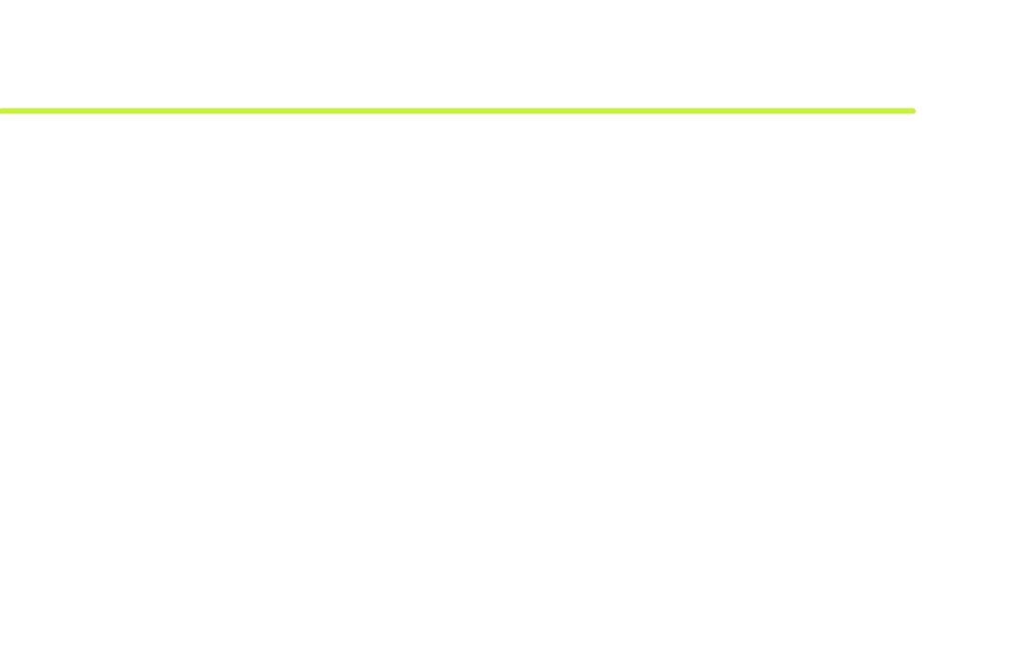

THE DECISION PATH
The analysis followed 3 simple steps
The analysis moved from understanding the data to making simple recommendations.
01
02
03
Understand
Explore
Recommend
Understand the sales data
Look at sales
Turn the results into
and business questions.
by products, categories,
simple business
customers, channels, and
recommendations.
time.
Three clear steps keep the analysis connected to decisions.

Slide 3
DATA QUALITY & CLEANING
Data was cleaned and prepared before doing the analysis.
Missing data was treated.
FIELD | MISSING | TREATMENT
Transaction Date | 0% | No missing data.
Item | 10% | Filled in From Category and price columns.
Price per Unit | 5% | Calculated using Total Spent ÷ Quantity.
Quantity | 5% | Filled using the median.
Total Spent | 5% | Calculated using Price × Quantity.
Discount Applied | 33% | Labeled as Unknown.
Data type: Transaction Date Was converted to date format
Outliers: Unusual Total Spent values were kept because they were valid, real transactions.
03

Slide 4
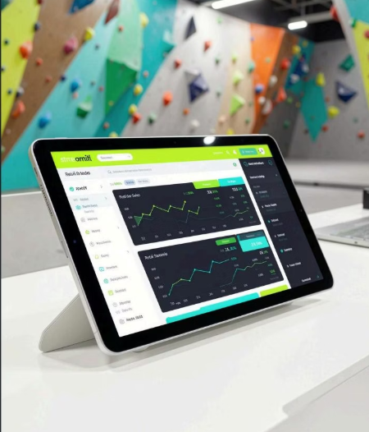



INTERACTIVE ANALYSIS
The Streamlit dashboard makes the analysis interactive
Use the finished analysis to move from a headline KPI into the evidence behind it.
Scan
Compare
Drill in
KPI cards and revenue trends
Categories, products, and discounts
Customers, payment usage, and location split

Slide 5
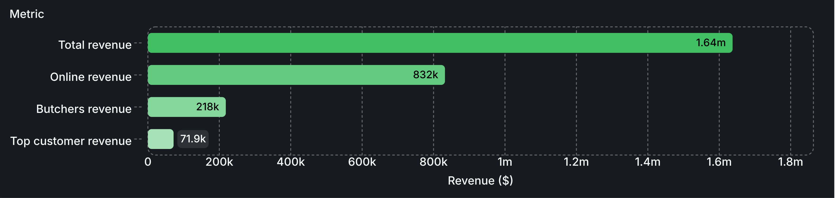
HEADLINE PERFORMANCE
Revenue is concentrated around a few clear winners
TOTAL REVENUE
TOP CATEGORY
TOP CHANNEL
TOP CUSTOMER
$1,637,367
$218,153
$831,922
$71,890
Butchers
Online
CUST_24

Slide 6











Top 5 Butchers Items by Revenue
Butchers was the best category
Series 1
Total Spent
Item
Item_25_BUT
23.7k
Item_22_BUT
22.6k
Item_23_BUT
22.2k
Item_20_BUT
20.1k
Item_16_BUT
13.2k
0
24k
TOP CATEGORY
BUSINESS FOCUS
$218,153
Keep it available
Use it as an example for other categories.
Category revenue
06

Slide 7









SALES CHANNEL
Online is the most important sales channel
Sales channel
49.19%
Online · 50.81%
50.81%
In store · 49.19%
Online revenue: $831,922.
Online and in store is nearly equal but online has slight edge.
To maintain this lead, make shopping easier, faster, and more reliable. Use bundles and special offers
to encourage customers to buy more.

Slide 8












PAYMENT BEHAVIOR
Cash Leads slightly in payment method
4,310
Cash transactions
payment methods are the most evenly split,
Credit Card · 32.77%
Cash · 34.27%
with cash leading slightly at 4,310 transactions
Cash · 34.27%
Keep cash payments
Digital Wallet · 32.95%
easy and encourage digital payments.
Credit Card · 32.77%
Digital Wallet · 32.9…

Slide 9


CUSTOMERS AND PRODUCTS
Some customers and products
bring much more money
than others
Entity
CUST_24
71.9k
Item_25_FUR
27.1k
CUST_24: $71,890 — the most important customer to keep.
0
20k
40k
60k
80k
Revenue $
Item_25_FUR: $27,101 — the highest-revenue product.
Keep an eye on these customers and products.

Slide 10
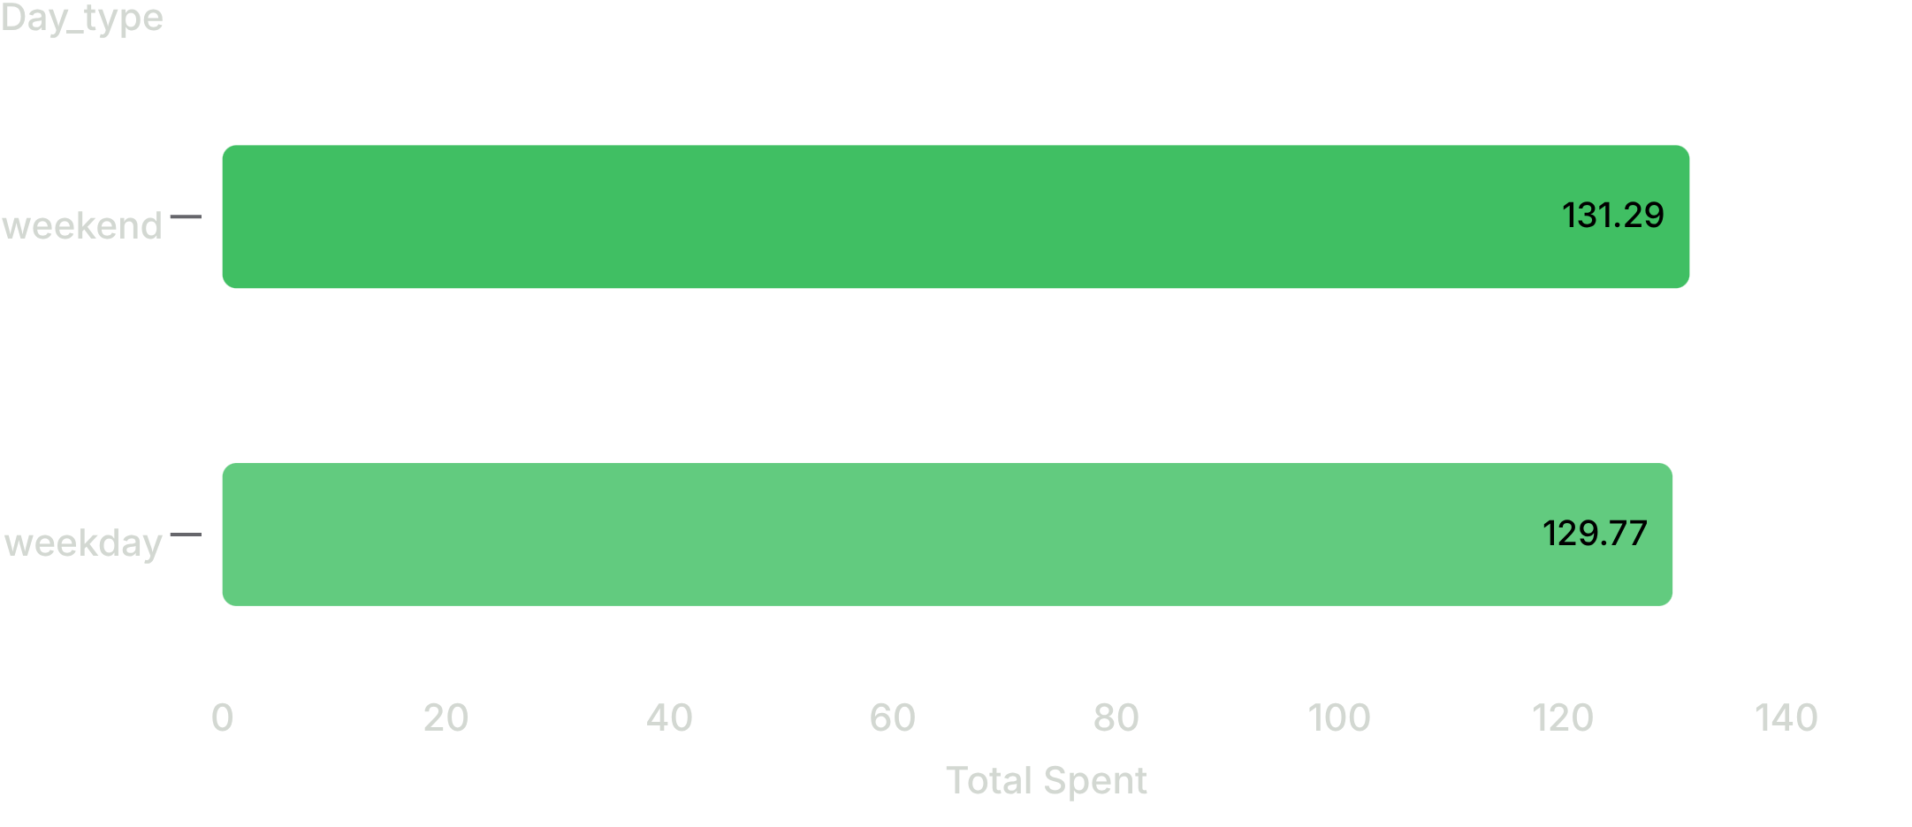

PURCHASING BEHAVIOR
Average Spending is Stable Across the week
Use weekends to offer product bundles, related products, and special offers
10

